Slide 1

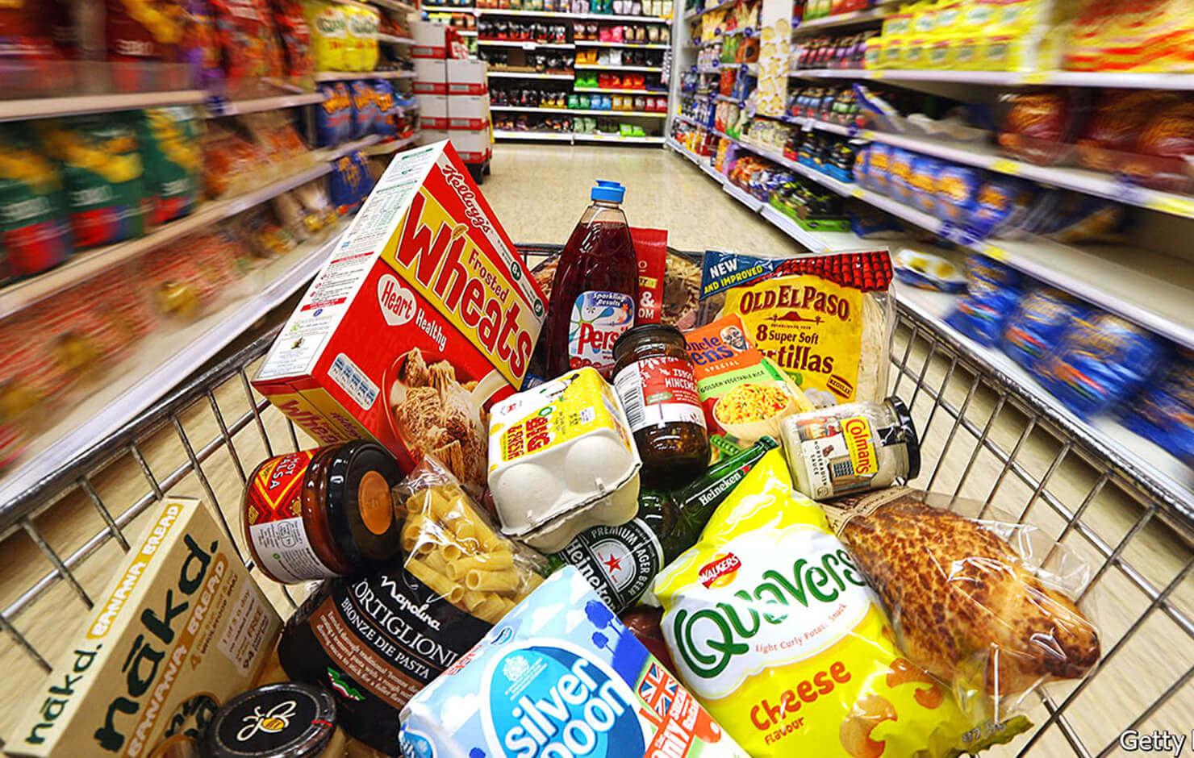
Project Phase II Market Research of New Product Launch for Lays Potato Chips
Prepared by Lin Fangzhou
Aug, 2023

Slide 2
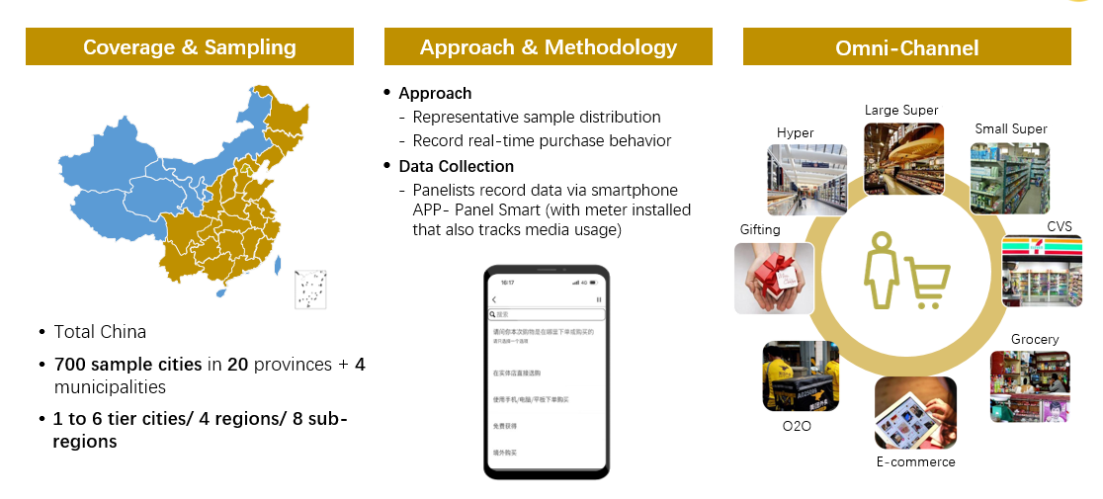
Who we are & What we offer

Slide 3
Project background Potato Chips account for the major sales of LAYS, however, the market showed significant decline in Q1 after the promising growth. Therefore, LAYS wanted to understand the reasons for the decline in the market，design and launch new products according to consumer needs
Sales contribution% in Lays
Potato Chips Sales Value Trend
Key business question
Identify Potato Chips Market Landscape
Any potential trend?
Competition landscape
Identify key behaviors of Lays
Driving factors of sales drop
Any potential opportunities/risks?
New product launch suggestions
Which consumers should Lays focus on?
Customer Preference towards potato chips
23Q1 GR%
-3.1%
(M. RMB)
59%
57%
MAT22Q1
MAT23Q1

Slide 4
Analytical Pathway
Industry Understanding
Business Understanding
2
Desktop Research
Chinese FMCG market understanding
Domain Knowledge of market research
Lay’s Business
Potato Chips’ market
1
Data Collection
Deployment & Recommendation
3
Kantar Worldpanel Household dataset
Questionnaire
6
PowerPoint
Working Process
Modelling
Data Preparation
Conjoint Analysis
K-Means
PCA
5
4
Data understanding
Data Cleaning and Transformation
Data Dictionary

Slide 5
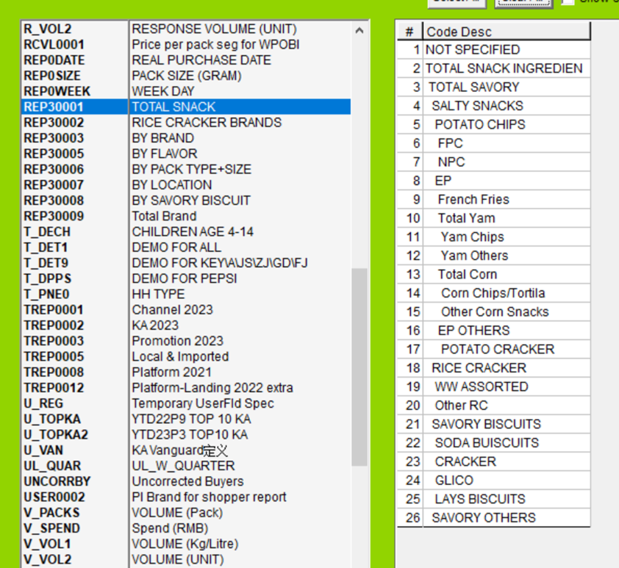



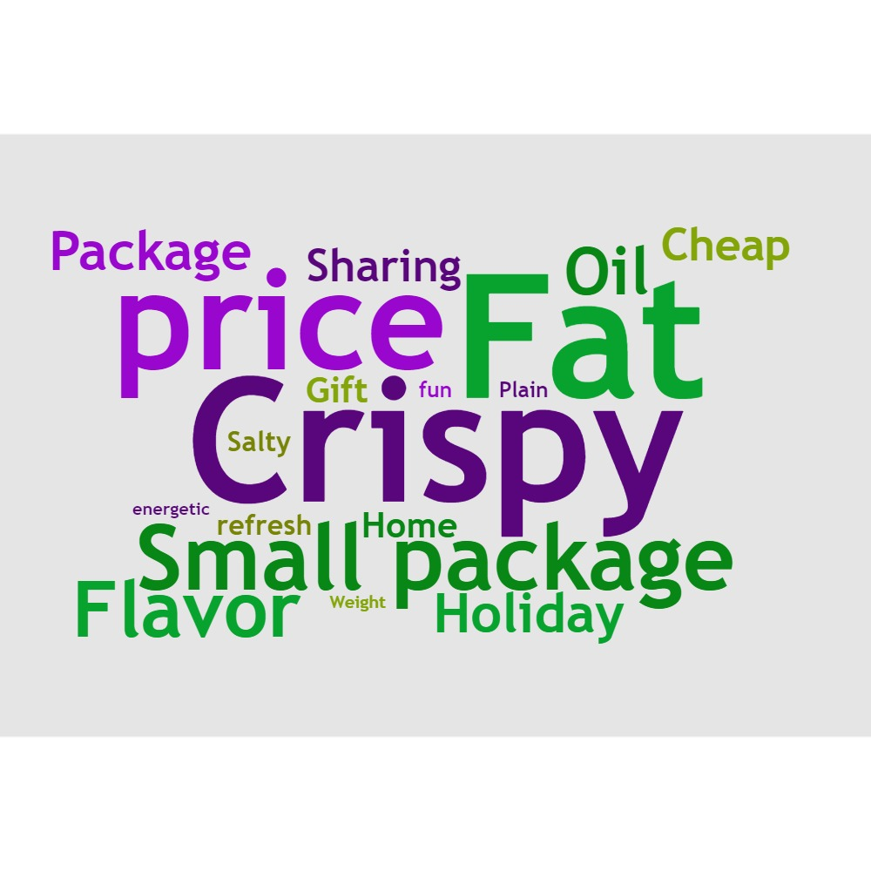



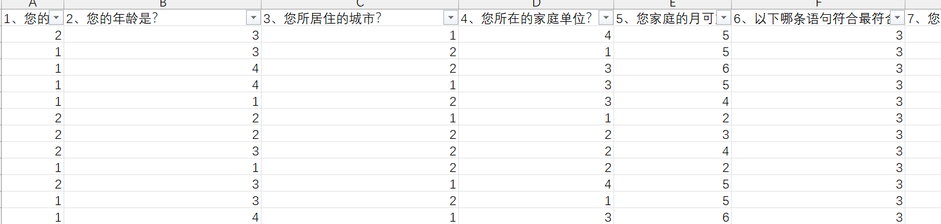
Data Set
Purchase data
(Household panel)
Comment data
(E-Commerce platform)
Attitude data
(Questionnaire)

Slide 6
Objective 1. Identify Potato Chips Market Landscape
What is the trend of Chinese Potato Chips Market?
What is the Competitive Landscape?

Slide 7
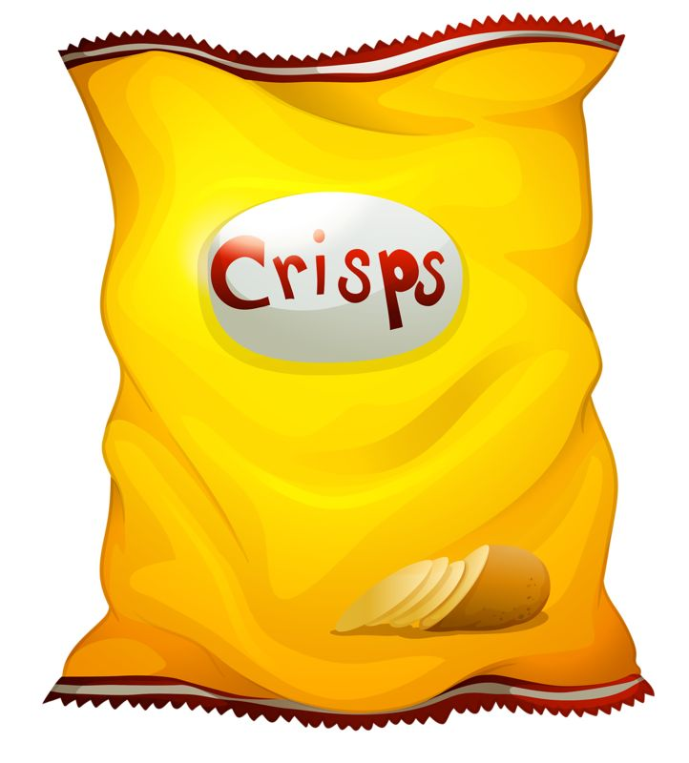
Objective 1. Identify Potato Chips Market Landscape
Market Trend
Competition Landscape
Conclusion
Consumer demand for potato chip package sizes started to polarize
Potato Chips | Val% by Package Size
 | Small Package <50g | Medium Package 50-110g | Large Package 110-220g | Super Large Package >220g
yoy Growth Rate | 1.5% | -4.6% | 2.9% | 3.3%

Slide 8
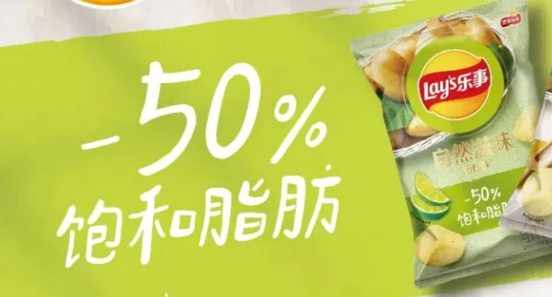
Consumers perceive snack categories differently; Due to health concerns, Taro Chips and Yam Chips still have some room for growth
Objective 1. Identify Potato Chips Market Landscape
Market Trend
Competition Landscape
Conclusion
Preferences for purchasing different snacks
Chips，MAT23Q1
Good flavor
More healthy
Data: Household panel, Kantar World panel

Slide 9
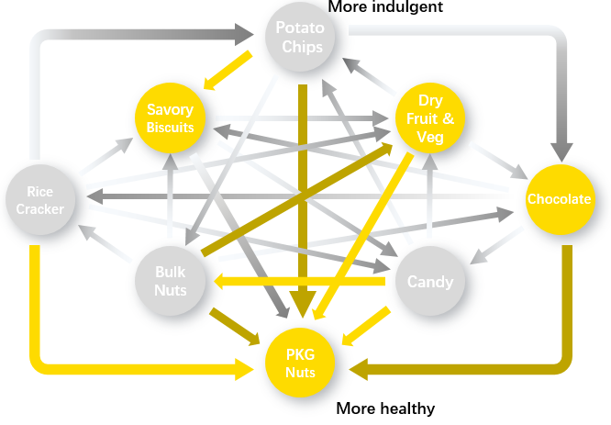
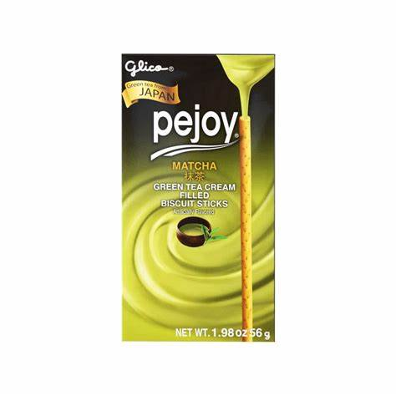
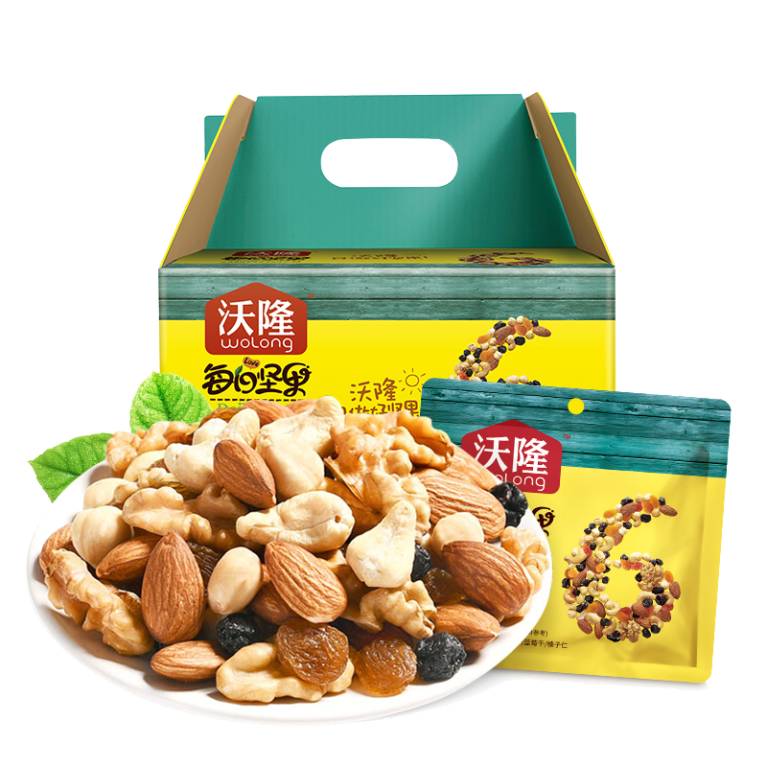
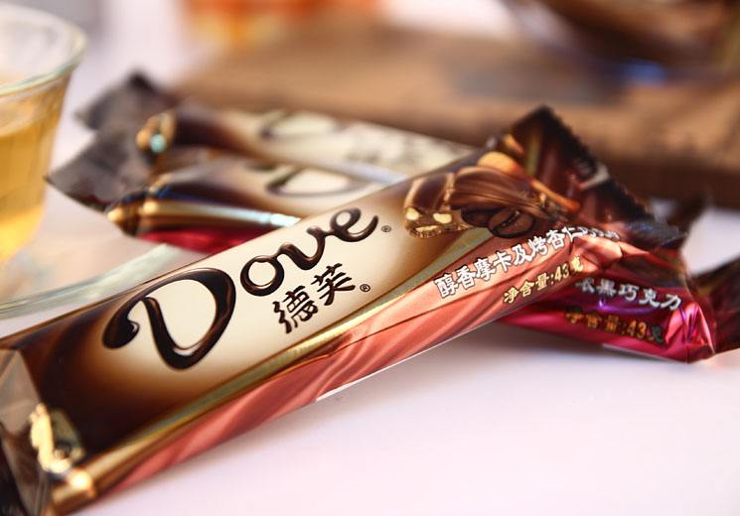
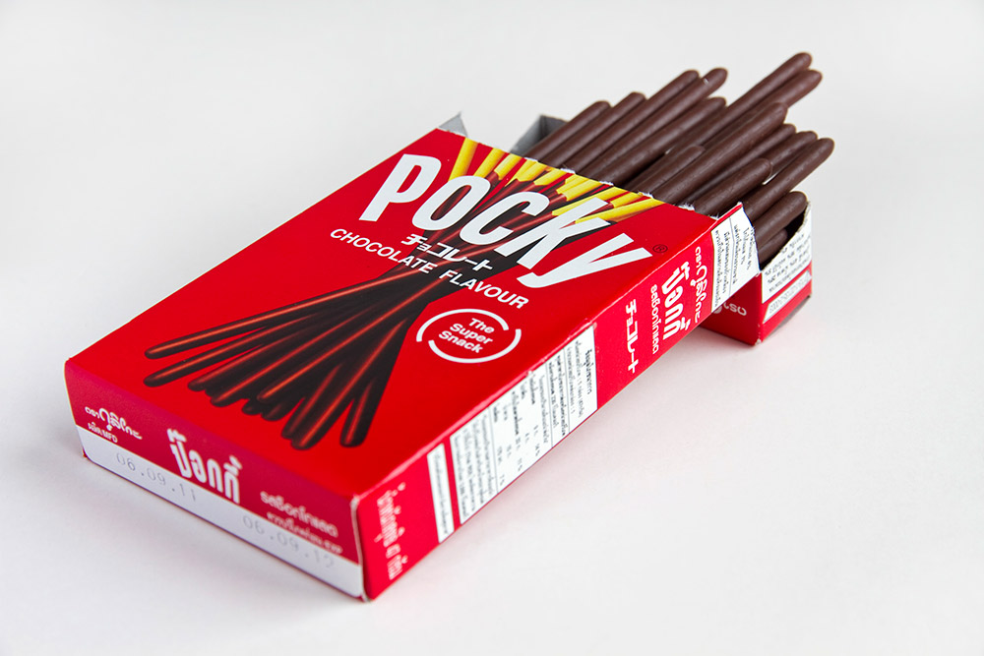
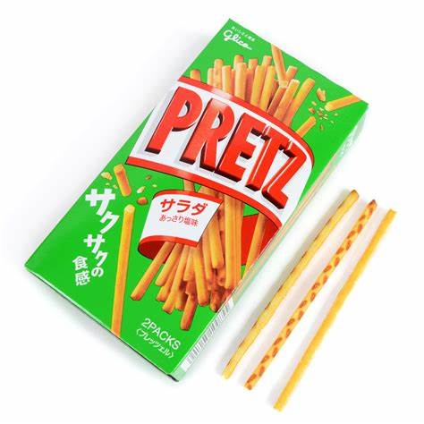
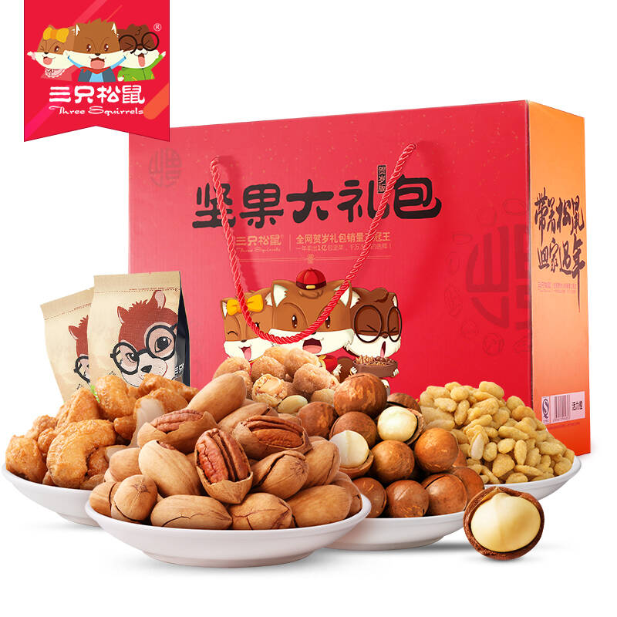
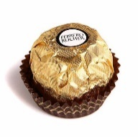
Objective 1. Identify Potato Chips Market Landscape
Market Trend
Competition Landscape
Conclusion
Through the consumers’ wallet sifting dynamics across snack adjacent categories , we can identify that Savory biscuits, nuts and chocolate are the main competing categories
Shift across SNACK
SOURCE OF VOLUME | Across Snacks | MAT23Q1 VS.LY
Switching Spending
<100 Mil RMB
100-150 Mil RMB
>150 Mil RMB

Slide 10

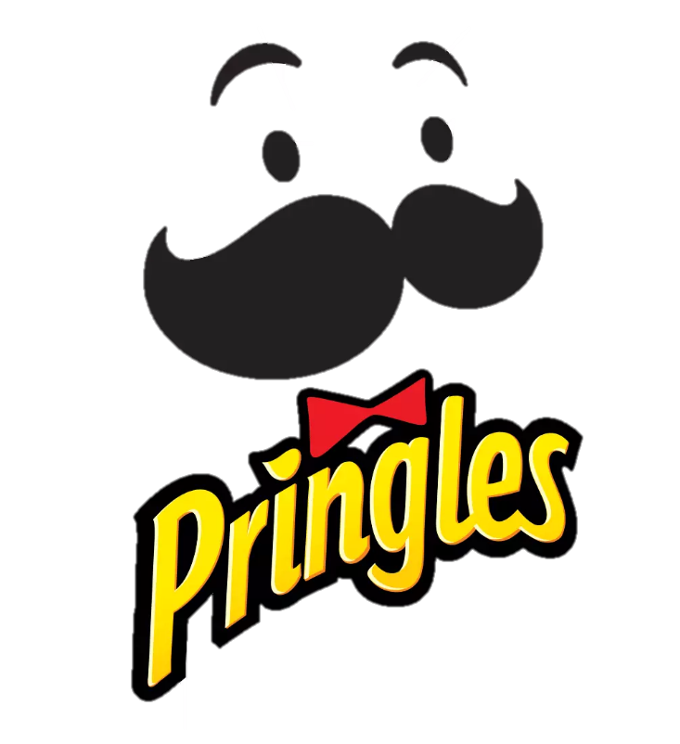
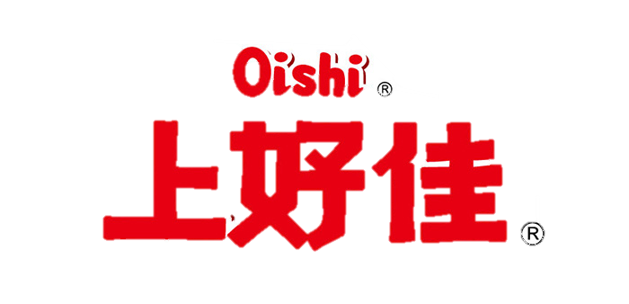


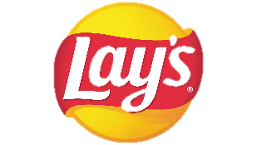
Objective 1. Identify Potato Chips Market Landscape
Market Trend
Competition Landscape
Conclusion
Lays, ORION, CALBEE and Oishi are top players in Chinese Potato Chips Market; In MAT2023Q1, Lays underperformed due to less category buyers and huge shift to ORION and CALBEE brands
VAL % | Potato Chips | Key to D Cities | MAT2023Q1
SOURCE OF VOLUME | Within Potato Chips| MAT23Q1 VS.LY

Slide 11
Objective 1. Identify Potato Chips Market Landscape
Market Trend
Competition Landscape
Conclusion
1
Consumer demand for package sizes started to polarize to suit different scenarios
2
Healthy concept products like Taro Chips and Yam Chips still have some room for growth
3
Across categories, Lays should notice chocolate, savory biscuits and nuts
Within Potato Chips category, ORION and CALBEE are the main competitors

Slide 12
Objective 2. Key behaviors of LAYs
Driving factors of sales drop
Any potential opportunities/risks?

Slide 13
Objective 2. Key behaviors of Lays
Driving Factors
Opportunities/Risks
Conclusions
Lays needs to speed up new buyer recruitment as currently it’s behind competitors. Thus, acquiring non buyers, retaining Brand’s current buyers and reclaiming Brands’ losing buyers are crucial.
Penetration %
-1.7
+1.8
+0.9

Slide 14
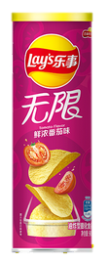
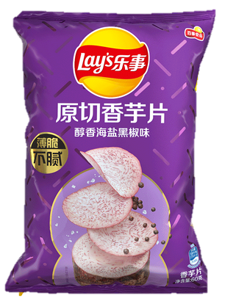
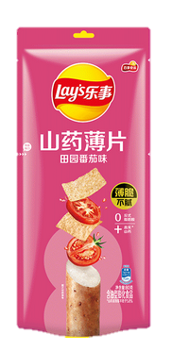
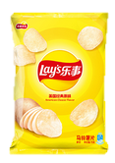
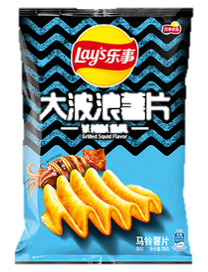
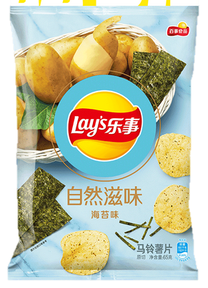
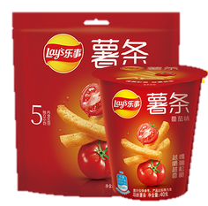
Objective 2. Key behaviors of Lays
Driving Factors
Opportunities/Risks
Conclusions
Consistent with the industry trend, healthy concept product lines (Nature taste, Taro Chips and Yam Chips) continue to grow
Healthy Concept Products
Classic | Stax | Wavy | Nature taste | Taro Chips | Yam Chips & Rolls | Lays French Fries
+0.9% | -2.8% | -0.9% | +6.8% | +2.3% | +1.1% | -1.3%
GR
Val%

Slide 15
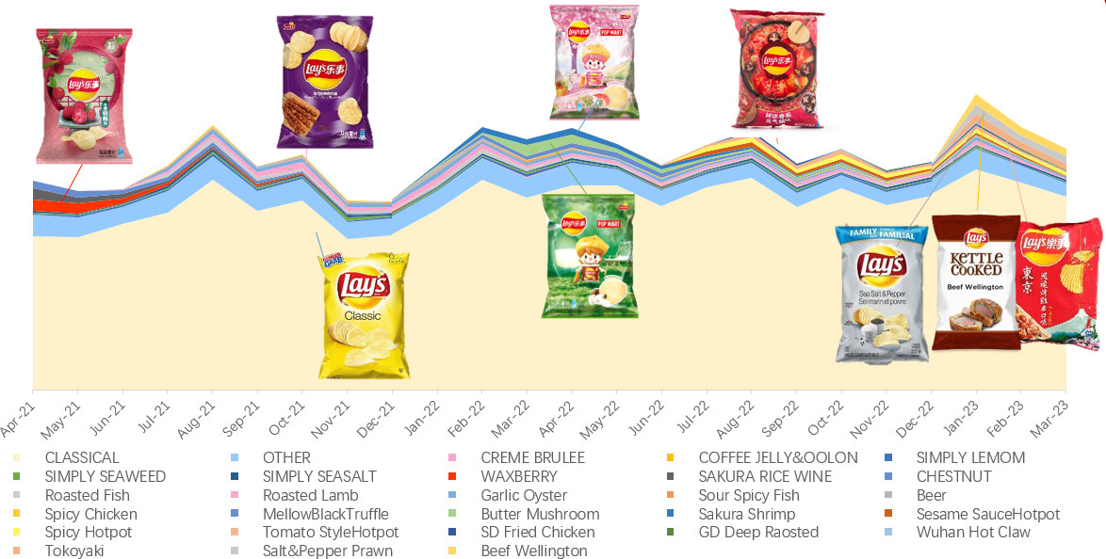
Objective 2. Key behaviors of Lays
Driving Factors
Opportunities/Risks
Conclusions
Seasonal In & Outs SKUs are important to drive business by staying relevant to consumers

Slide 16
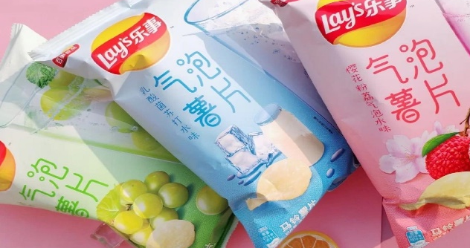
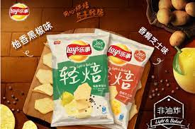
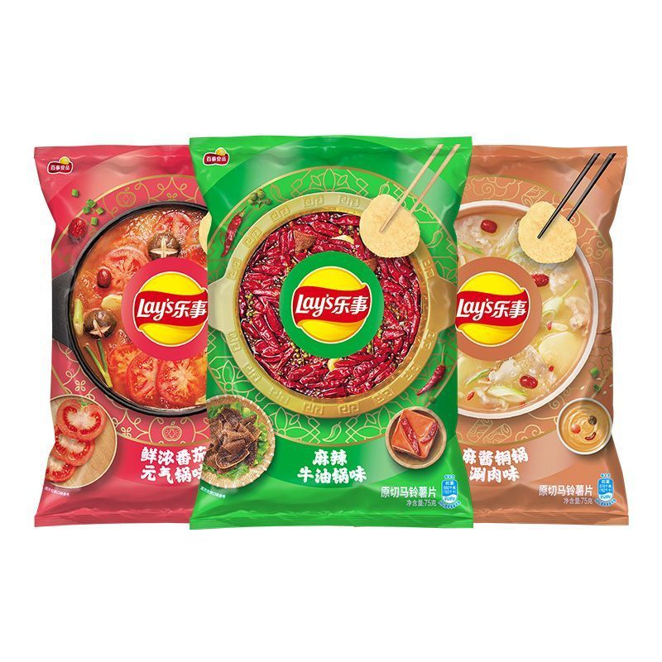
Objective 2. Key behaviors of Lays
Driving Factors
Opportunities/Risks
Conclusions
After launching for the same period, the penetration rates of Light & Baked flavor and Hotpot flavor are similar. However, Hotpot flavor accumulate higher penetration at the beginning.
Light & Baked Flavor
Sparkling Water Flavor
Hotpot Flavor
As representative of Mild flavor
As representative of Sweet flavor
As representative of Strong flavor
Cumulative Penetration% After Launch
Cumulative Penetration% After Launch
Cumulative Penetration% After Launch
Steeper at the beginning
1P
11P
22P
1P
11P
22P
1P
11P
22P

Slide 17

Light & Baked flavor has a higher repeat rate compared to Hotpot flavor.
Objective 2. Key behaviors of Lays
Driving Factors
Opportunities/Risks
Conclusions
Light & Baked Flavor
Sparkling Water Flavor
Hotpot Flavor
As representative of Mild flavor
As representative of Sweet flavor
As representative of Strong flavor
Cumulative Repeat% After Launch
Cumulative Repeat% After Launch
Cumulative Repeat% After Launch
1P
11P
22P
1P
11P
22P
1P
11P
22P

Slide 18
Objective 2. Key behaviors of Lays
Driving Factors
Opportunities/Risks
Conclusions
1
Due to huge decline in penetration this year, Lays needs to speed up new buyer recruitment as currently it’s behind competitors.
2
New flavours can be developed based on the repeat rate and penetration of previous launches

Slide 19
Objective 3. New Product launch suggestions
Which consumers should LAYs focus on?
Customer Preference towards potato chips

Slide 20
Goal
Objective 3. New Product Launch Suggestions
Acquire
Retain
Non-PC Buyer
(as well as PC Demand Decrease Buyer)
Lays PC Current Buyer
Reclaim
Non-Lays PC Buyer
(as well as Lays PC Demand Decrease Buyer;
still in PC market )

Slide 21
Objective 3. New Product Launch Suggestions
Key questions
What are the key barriers for non-buyers to try Potato Chips?
Why did lost Potato Chips buyers leave us?
What are the triggers for Lays Potato Chips existing buyers to buy our Brand? Compare to other Brands?

Slide 22
Objective 3. New Product Launch Suggestions
Questionnaire Design
Non-PC Buyers
PC Buyers
Summary &
Recommendation
Questionnaire contents..
Variables | Type | Description
Gender | Categorical | 1=Male, 0=Female
Age | Ordinal | 1=15-24 y.o; 2=25-34 y.o; 3=35-44 y.o; 4=45-54 y.o; 5= more than 54 y.o;
City Tier | Categorical | 1=Key&A Cities; 0=B-D Cities
Life Stage | Categorical | Young Singles&Couples, Mixed Families, Teenager Families, Adult Families, Empty Nest Families
Monthly Income | Ordinal | 1= less than 5k RMB; = 5-7k RMB; 3= 7-9k RMB; 4= 9-12k RMB; 5=12-16k RMB; 6= more than 16k RMB
Frequency | Ordinal | 1= once for a few months; 2= 1-2 times/months; 3= 3-6 times/months; 4= >6 times/months
Annual Spend | Ordinal | 1= less than 50 RMB; 2= 50-100 RMB; 3= 100-150 RMB; 4= 150-200 RMB; 5= more than 200 RMB
Channel | Categorical | Hyper, Super, CVS, Accepting, EC, O2O
Occasion | Categorical | Festivals, Friends, Chatting, TV, Outdoor, Study&Work, Diet
Attitude towards PC | Nominal
Attitude towards Brands | Nominal
Preference for different portfolios | Ordinal | Rated from 0 to 10

Slide 23
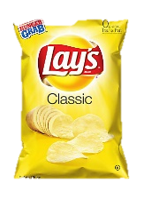
Objective 3. New Product Launch Suggestions
Questionnaire Design
Non-PC Buyers
PC Buyers
Summary &
Recommendation
For Conjoint Analysis..
Attributes
Levels
Package Size
Small Package
(<=50g)
Medium Package
(50-120g)
Large Package
(110-220g)
Super Large Package
（>220g）
Price
5 RMB
10 RMB
15 RMB
Flavor
Mild
Strong
Sweet
Traditional Flavor
Texture
Thin
Thick
Oil
Baked crisps(no oil added)
Deep-fried chips

Slide 24
Objective 3. New Product Launch Suggestions
Questionnaire Design
Non-PC Buyers
PC Buyers
Summary &
Recommendation
Collected samples..
Group | Number | Ratio
Non-PC buyers | 187 | 20.7%
Non-Lays buyers/Lays lost buyers (but still in PC market) | 201 | 22.3%
Lays current buyers | 515 | 57%

Slide 25
Objective 3. New Product Launch Suggestions
Questionnaire Design
Non-PC Buyers
PC Buyers
Summary &
Recommendation
What are the barriers to
purchase Potato Chips for Non-PC Buyers?

Slide 26





Objective 3. New Product Launch Suggestions
Questionnaire Design
Non-PC Buyers
PC Buyers
Summary &
Recommendation
Y&M | Adult | E. Nest | Teen | Y S&C
 | Total
Main consumer | - | <15 y.o. | 18-24, 35-44 y.o. | 45-64 y.o. | <18 y.o. | 25-34 y.o.
Key barriers (by demo only highlight differentiating barrier) | Not healthy High Calories Much additives Fried snack | Less stock up needs after COVID (less family time at home after Covid) Can’t find package size I want (prefer Independent small pack, won't overeat) | (Same barriers as total) | High health concern Fried | Negative info online | Tired of eating (segment lack of excitement) Can’t find package size I want (prefer Independent small pack, convenient)
Competing category (rank by importance) | Nuts, cheese, seafood snack | Seaweed, Glico biscuits Snacking Cheese, | Nuts, bean snack, savory biscuit | Nuts, Chinese pastry, Dry Vegetable & Fruits | Nuts, cheese, Rice Cracker | Nuts, Glico biscuits, seafood snack
Key Insight | Need to bridge our brand with healthy image to reduce barriers | Parents are critical gate keeper to avoid overweight Need to communicate consumption occasion to encourage stock up | Low calories & natural ingredient products are good to engage them | Difficult for PC to fulfill their functional healthy needs | Easily influenced by online negative information | Like to seek taste enjoyment and excitement Convenient package solution is value added
Action for Lays | More resources on existing healthy concept product: Simply/TARO/Yam Innovation on low calories snacks | Communicate different consumption occasion Provide Convenient package | Expand penetration among Simply/TARO | Some occasion penetration like CNY to promote the family reunion | Positive Word-of-Mouth Digital engagement to remove the concern | Keep bring PC new news to them Provide Convenient package

Slide 27
Objective 3. New Product Launch Suggestions
Questionnaire Design
Non-PC Buyers
PC Buyers
Summary &
Recommendation
What are the Barriers of Lays Lost Buyers?

Slide 28
Objective 3. New Product Launch Suggestions
Questionnaire Design
Non-PC Buyers
PC Buyers
Summary &
Recommendation
Top 10 Potato Chips Category Claimed Barriers among Non-PC Buyers
Top 10 Claimed Barriers among Brand Lost Buyers
A
All about Product
(health concern)
Sample Size: Non-PC buyers（157）
Sample Size: Lays PC Lost（129）

Slide 29
Objective 3. New Product Launch Suggestions
Questionnaire Design
Non-PC Buyers
PC Buyers
Summary &
Recommendation
What are the triggers to buy Lays Potato Chips?

Slide 30
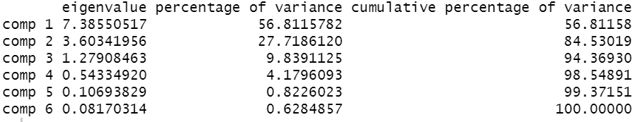
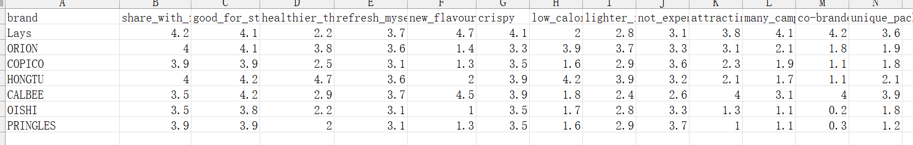
Objective 3. New Product Launch Suggestions
Questionnaire Design
Non-PC Buyers
PC Buyers
Summary &
Recommendation
Two components explain 84.5 percent of the variance in the ratings
A number of Potato Chips brands (observations)
Rated brands on attributes/comments such as “refresh myself”, “not expensive”, “attracting advertisement”, etc. (dimensions)

Slide 31
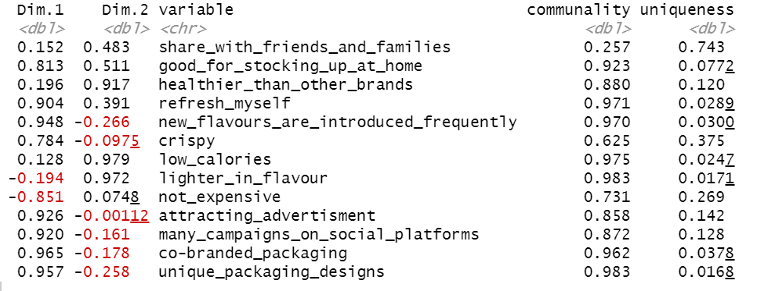
Objective 3. New Product Launch Suggestions
Questionnaire Design
Non-PC Buyers
PC Buyers
Summary &
Recommendation
Dimension 1
Leisure, entertainment and advertisement
Dimension 2
Health

Slide 32
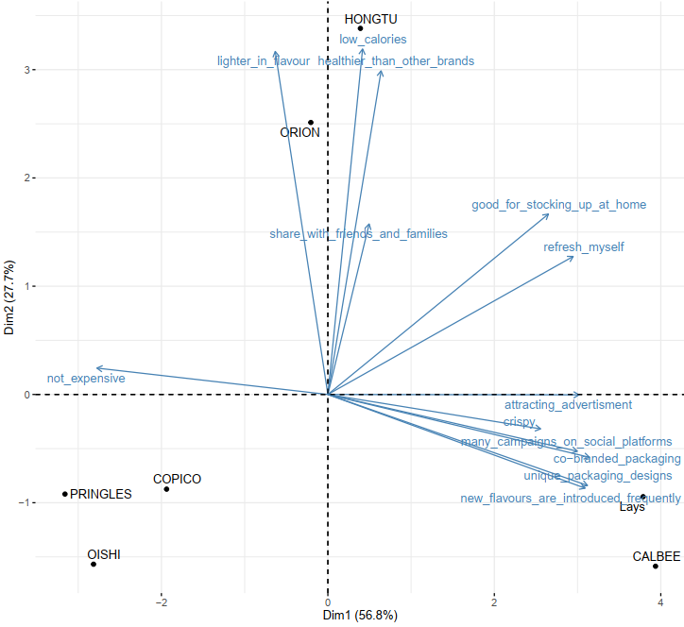
Objective 3. New Product Launch Suggestions
Questionnaire Design
Non-PC Buyers
PC Buyers
Summary &
Recommendation
Lays scores highly on the first factor
Barriers of Lays

Slide 33
Objective 3. New Product Launch Suggestions
Questionnaire Design
Non-PC Buyers
PC Buyers
Summary &
Recommendation
Who are the main customers of Potato Chips?

Slide 34
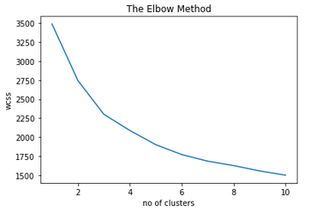
Objective 3. New Product Launch Suggestions
Questionnaire Design
Non-PC Buyers
PC Buyers
Summary &
Recommendation
For the K-means clustering, only Demographic & Purchase data were used. By using the elbow method, a cluster of number of 6 was chosen.

Slide 35
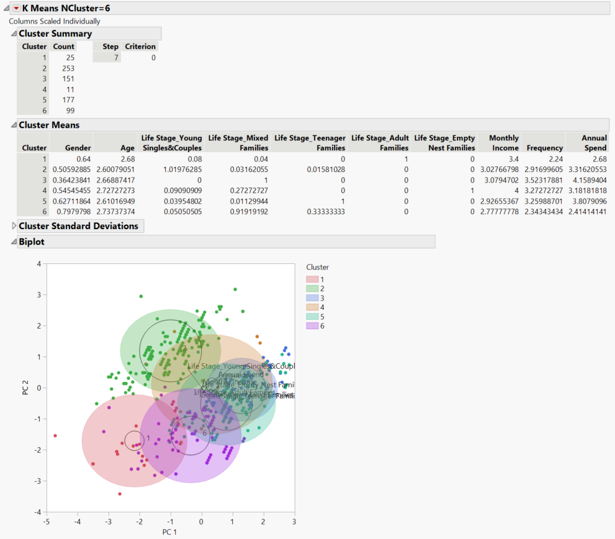
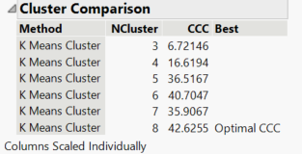
Objective 3. New Product Launch Suggestions
Questionnaire Design
Non-PC Buyers
PC Buyers
Summary &
Recommendation

Slide 36
Objective 3. New Product Launch Suggestions
Questionnaire Design
Non-PC Buyers
PC Buyers

Slide 37




Objective 3. New Product Launch Suggestions
Questionnaire Design
Non-PC Buyers
PC Buyers
Summary &
Recommendation
Profile 1 （N=253）
Profile 2 （N= 151）
Demographic
Demographic
Predominantly 34-44 y.o
High Income
Teenager & Adult Families
Predominantly females, 25-44 y.o
Single & Mixed Families
Purchase Behavior
Purchase Behavior
Heavy buyers, mostly purchase PC 3-6 times/month
Low Frequency
High value per purchase occasion
Occasions
Channel Preference
Stocking up at home
Chatting
Outdoor
Share with friends
Channel Preference
Occasions
Hypermarket
Supermarket
E-commerce
CVS
O2O
Hypermarket
Festivals
Stocking up at home
Profile 3 （N=177）
Profile 4 （N=99）
Demographic
Demographic
Young male, mostly 23-34 y.o
Adult Families
Predominantly >35 y.o
Purchase Behavior
Purchase Behavior
High frequency consumption, >3 times/month
Purchase PC 3-6 times/ month, annual spend 150-200RMB
Occasions
Channel Preference
Occasions
Channel Preference
Study & Work
Stocking up at home
Share with friends
CVS
Supermarket
Small Super
Small Super
Supermarket
CVS
Festivals
Watch TV

Slide 38
Objective 3. New Product Launch Suggestions
Questionnaire Design
Non-PC Buyers
PC Buyers
Summary &
Recommendation
Texture
Price
Total
Profile1
Profile2
Oil
Profile3
Package Size
Profile4
Flavor
Oil
Flavor
Package Size
Price
Texture

Slide 39


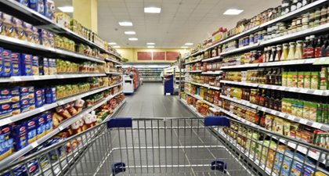

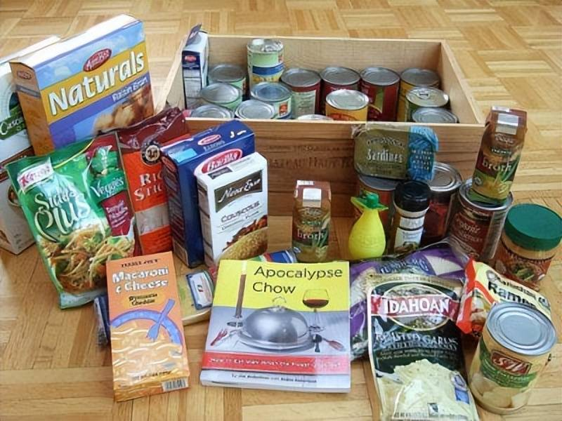
Teenager & Adult Families: focus on middle-income families in A cities, high purchase frequency, prefer online channels; the main consumption scenes are festivals and family reunions.
Objective 3. New Product Launch Suggestions
Questionnaire Design
Non-PC Buyers
PC Buyers
Summary &
Recommendation
Demographic
Channel Preference
Relative Importance of Attributes
Index:
Teenager Family 113
Adult Family 117
E-Commerce
Supermarket
Oil
Monthly Income 9-12K
Index： 104
Occasions
Flavor
A Cities
Index： 106
Festivals
Package Size
Purchase Behavior
3 times/month Index：126
Annual Spend > 150 RMB
Index：128
Stock up at home
Texture
Price
*Index = Percentage of Consumer segmentation vs. Percentage of Overall PC Consumers *100

Slide 40
Objective 3. New Product Launch Suggestions
Questionnaire Design
Non-PC Buyers
PC Buyers
Summary &
Recommendation
Attribute | Level | Profile 1
 |  | Importance(%) | Utility
Oil | Baked crisps(no oil added) | 20.8 | -1.261
 | Deep-fried crisps |  | 1.261
Texture | thick | 3.3 | -0.201
 | Thin |  | 0.201
Flavor | Mild Flavor | 45.1 | -3.637
 | Strong Flavor |  | 1.843
 | Sweet Flavor |  | 1.272
 | Traditional Flavor |  | 0.522
Price | 5 rmb | 13.7 | 0.22
 | 10 rmb |  | 0.719
 | 15 rmb |  | -0.94
Package Size | 50g/pack，small | 17.2 | -0.75
 | 100g/pack，medium |  | -0.978
 | 150g/pack，large |  | 0.621
 | 200g/pack，super large |  | 1.107
Flavor & Oil are identified as the most important factors
Within flavor, the most utility was obtained from strong flavor
Super Large package size is preferred
Recommendations
Incorporating regional flavors as well as festive features into new product
Innovation on sweet flavor (e.g. Honey butter chips of CALBEE can be benchmarked )
Constant | 4.984
Pearson’s R Value | 0.778
Pearson’s R Sig | .000
Kendall’s tau | 0.619
Kendall’s tau Sig | .000

Slide 41
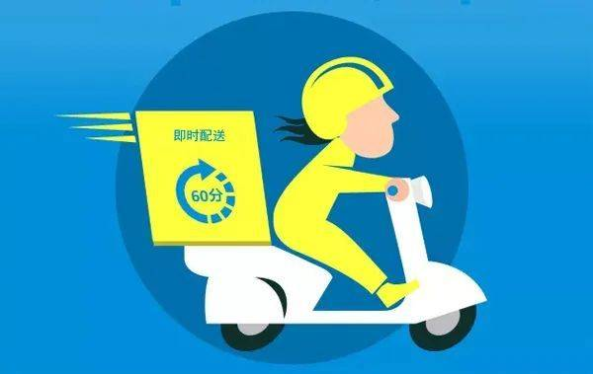
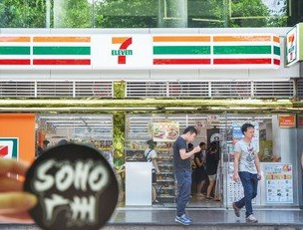
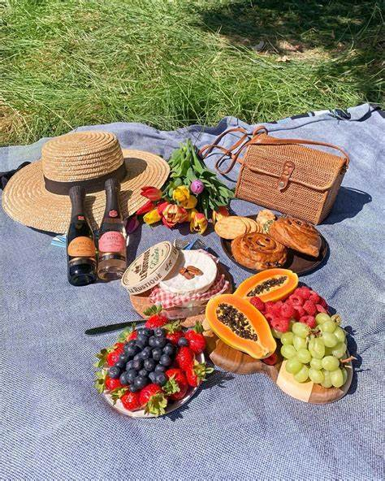
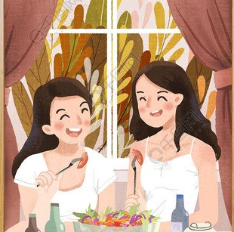
Young women: mainly from Single & Mixed family in B-D cities, prefer O2O and CVS channels; Socializing(sharing with friends and outdoor) is the main purpose of consumption
Objective 3. New Product Launch Suggestions
Questionnaire Design
Non-PC Buyers
PC Buyers
Summary &
Recommendation
Demographic
Channel Preference
Relative Importance of Attributes
Index:
Single & Mixed Family 115
Female 139
25-44 years old Frequency: 80%
O2O
CVS
Texture
Package Size
Monthly Income 7-9K
Frequency： 40%
Occasions
Price
Oil
BCD Cities
Frequency：70%
Outdoor
Share with friends
Purchase Behavior
<2 times/month Index：132
Annual Spend > 150 RMB
Index：128
Flavor
*Index = Percentage of Consumer segmentation vs. Percentage of Overall PC Consumers *100

Slide 42
Objective 3. New Product Launch Suggestions
Questionnaire Design
Non-PC Buyers
PC Buyers
Summary &
Recommendation
Attribute | Level | Profile 2
 |  | Importance(%) | Utility
Oil | Baked crisps(no oil added) | 46.1 | 2.644
 | Deep-fried crisps |  | -2.644
Texture | thick | 3.6 | 0.208
 | Thin |  | -0.208
Flavor | Mild Flavor | 23.6 | 1.611
 | Strong Flavor |  | -1.092
 | Sweet Flavor |  | 0.106
 | Traditional Flavor |  | -0.625
Price | 5 rmb | 15.1 | 0.593
 | 10 rmb |  | 0.54
 | 15 rmb |  | -1.133
Package Size | 50g/pack，small | 11.6 | 0.229
 | 100g/pack，medium |  | -0.815
 | 150g/pack，large |  | 0.518
 | 200g/pack，super large |  | 0.068
To be in shape and healthy, women are especially conscious of Flavor & Oil
Within flavor, the most utility was obtained from mild flavor
Large and small packages are suitable for different scenarios
Recommendations
Apply portable small packages and super large packages to current mild flavor products( e.g. nature taste and Taro Chips)
Constant | 8.311
Pearson’s R Value | 0.765
Pearson’s R Sig | .000
Kendall’s tau | 0.655
Kendall’s tau Sig | .000

Slide 43


Objective 3. New Product Launch Suggestions
Questionnaire Design
Non-PC Buyers
PC Buyers
Summary &
Recommendation
Young men: mainly from Single & Mixed family in B-D cities; heavy buyers of Potato chips; prefer Offline channels (Supermarket & CVS); the main consumption scenes are study & work as well as sharing with friends
Demographic
Channel Preference
Relative Importance of Attributes
Index:
Single & Mixed Family 111
Male 119
25-34 years old 108
Supermarket
CVS
Texture
Package Size
Monthly Income 7-9K 106
Occasions
Price
Oil
BCD Cities
Frequency：70%
Study & Work
Share with friends
Purchase Behavior
>3 times/month Index：110
Annual Spend > 150 RMB
Index：134
Flavor
*Tendency Index = Percentage of Consumer segmentation vs. Percentage of Overall PC Consumers *100

Slide 44
Objective 3. New Product Launch Suggestions
Questionnaire Design
Non-PC Buyers
PC Buyers
Summary &
Recommendation
Attribute | Level | Profile 3
 |  | Importance(%) | Utility
Oil | Baked crisps(no oil added) | 25.7 | -1.571
 | Deep-fried crisps |  | 1.571
Texture | thick | 3.9 | -0.213
 | Thin |  | 0.213
Flavor | Mild Flavor | 40.6 | 1.911
 | Strong Flavor |  | 5.932
 | Sweet Flavor |  | -3.906
 | Traditional Flavor |  | -3.937
Price | 5 rmb | 15.6 | 0.61
 | 10 rmb |  | 0.413
 | 15 rmb |  | -1.023
Package Size | 50g/pack，small | 14.2 | -1.322
 | 100g/pack，medium |  | 0.129
 | 150g/pack，large |  | 0.162
 | 200g/pack，super large |  | 1.031
Less concern about the functionality and health of the product
deep-fried crisp with strong Flavor and thin texture is prefered
Super large package size is prefered
Recommendations
Introduce super large package size to current top-selling strong flavor products (e.g. Hotpot Series)
Communicate sharing and relaxing image, combined with at-home scenarios
Constant | 5.786
Pearson’s R Value | 0.687
Pearson’s R Sig | .000
Kendall’s tau | 0.583
Kendall’s tau Sig | .000

Slide 45


Adult & Empty Nest Families: mainly high-income families in B-D cities, prefer Ecommerce and CVS channels; the main consumption scenes are festivals.
Objective 3. New Product Launch Suggestions
Questionnaire Design
Non-PC Buyers
PC Buyers
Summary &
Recommendation
Demographic
Channel Preference
Relative Importance of Attributes
Adult Family Index ：117
Male 111
E-Commerce
Supermarket
Oil
Monthly Income >12K
Index： 123
Occasions
Flavor
BCD Cities
Frequency：80%
Festivals
Package Size
Purchase Behavior
<3 times/month Index：113
Annual Spend < 150 RMB
Index：139
Stock up at home
Texture
Price
*Tendency Index = Percentage of Consumer segmentation vs. Percentage of Overall PC Consumers *100

Slide 46
Objective 3. New Product Launch Suggestions
Questionnaire Design
Non-PC Buyers
PC Buyers
Summary &
Recommendation
Attribute | Level | Profile 4
 |  | Importance(%) | Utility
Oil | Baked crisps(no oil added) | 18.7 | 2.166
 | Deep-fried crisps |  | -2.166
Texture | thick | 1.5 | 0.172
 | Thin |  | -0.172
Flavor | Mild Flavor | 59.6 | 9.029
 | Strong Flavor |  | -2.988
 | Sweet Flavor |  | -4.773
 | Traditional Flavor |  | -1.267
Price | 5 rmb | 5.8 | 0.459
 | 10 rmb |  | -0.884
 | 15 rmb |  | 0.424
Package Size | 50g/pack，small | 14.4 | 0.052
 | 100g/pack，medium |  | -1.599
 | 150g/pack，large |  | -0.186
 | 200g/pack，super large |  | 1.733
Flavor is identified as the most important factor
Within flavor, the most utility was obtained from mild flavor
Recommendations
Similar with Group 2
Constant | 7.799
Pearson’s R Value | 0.799
Pearson’s R Sig | .000
Kendall’s tau | 0.555
Kendall’s tau Sig | .000

Slide 47
Objective 3. New Product Launch Suggestions
Questionnaire Design
Non-PC Buyers
PC Buyers
Summary &
Recommendation
For PC non/Lost buyers…
For Lays non/Lost buyers…
For Lays buyers…
Barriers
Barriers
Triggers
Health
Innovation
High Calories
Much additives
Fried
Too fake flavor
Not refreshing enough
Not fun when eat
New flavors introduced frequently
Key findings
Communication
Taste
Attracting advertisement
Co-branded packaging
Lack of excitement
More resources on existing healthy concept product: Simply/TARO/Yam
Innovation on low calories snacks
Communicate health image of specific product lines
Continue the multi-flavor strategy to expand penetration
Further research among PC buyers for taste improvement
Keep introducing new products every season
Continue communicating sharing and happiness image
Recommendations
(See the results of conjoint analysis)

Slide 48
Objective 3. New Product Launch Suggestions
Questionnaire Design
Non-PC Buyers
PC Buyers
Summary &
Recommendation
For Total PC buyers…
Product Lines
Develop “Healthy + Portable” Concept Products---- apply portable small packages to current mild flavor products(e.g., nature taste and Taro Chips)
Develop Family Sharing Packs---- Incorporate regional flavors as well as festive features into new products, with super larger package
Innovation on sweet flavor (e.g., Honey butter chips)
Apply super large package size to current top-selling strong flavor products and mild flavor products(e.g., Hotpot Series and Nature Series)

